Slide 1
Hjärta Addition HB

Slide 2
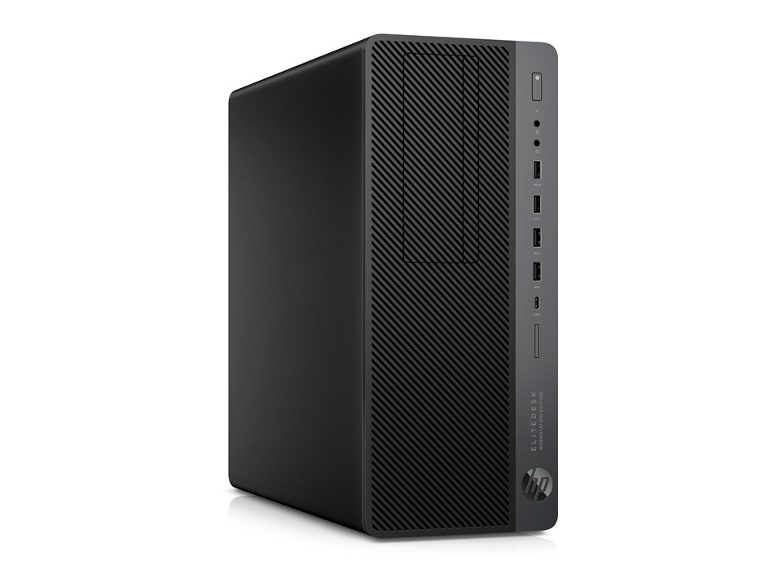
Workstation
HP EliteDesk 800 g4 MT Workstation Edition

Slide 3
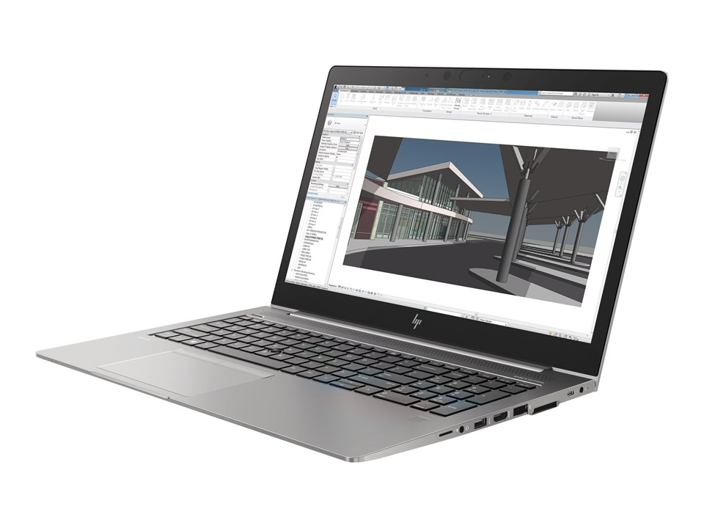
Laptop
HP ZBook 15u G5 Mobile Workstation

Slide 4
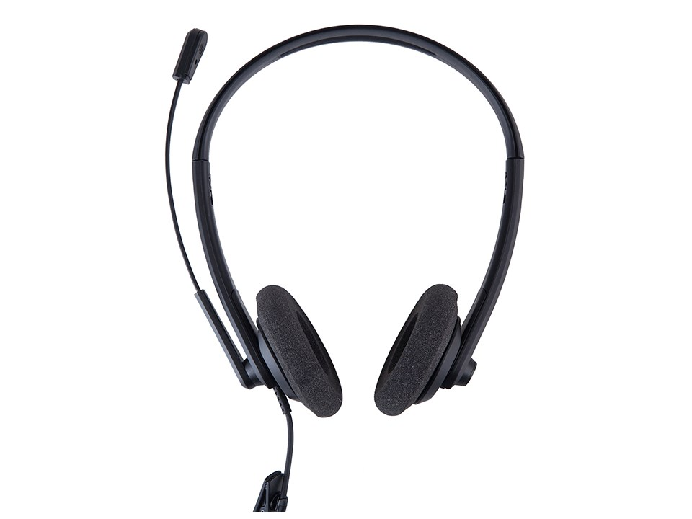
Headset
Voxicon U200 Duo Headset

Slide 5
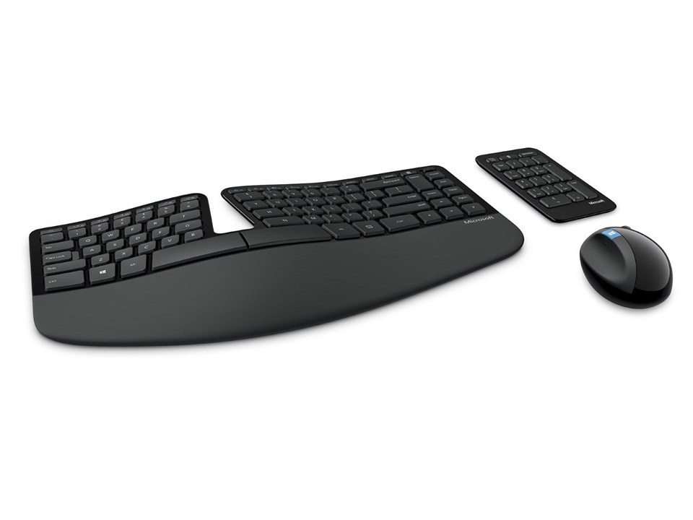
Tangentbord och mus
Microsoft Sculpt Ergonomic tangentbord och mus

Slide 6
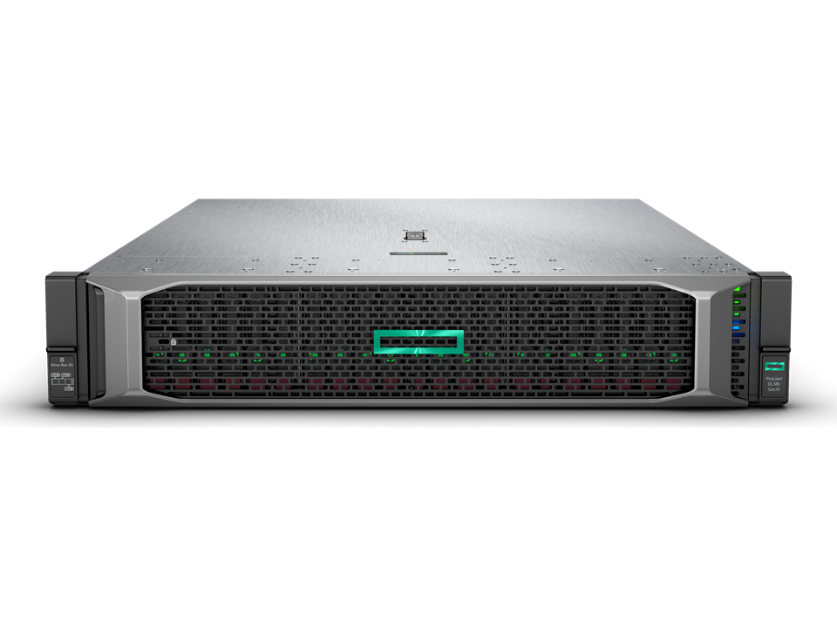
Server
HPE ProLiant DL385 Gen10 - 1.2TB & extra RAM

Slide 7
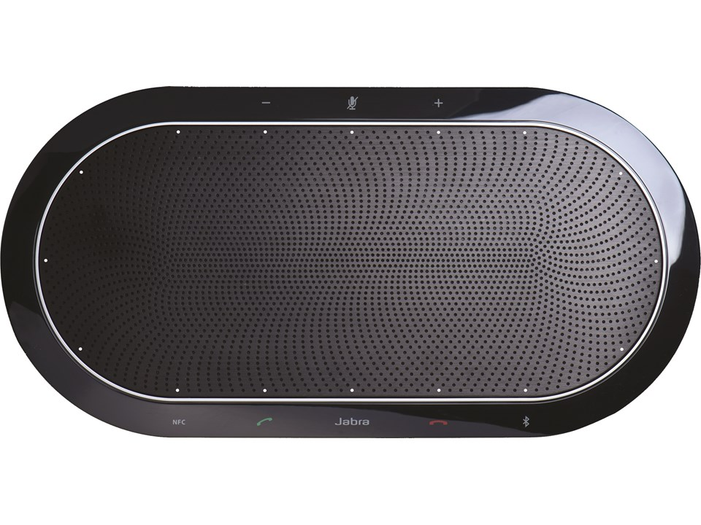
Konferenstelefon
Jabra SPEAK 810 for MS

Slide 8
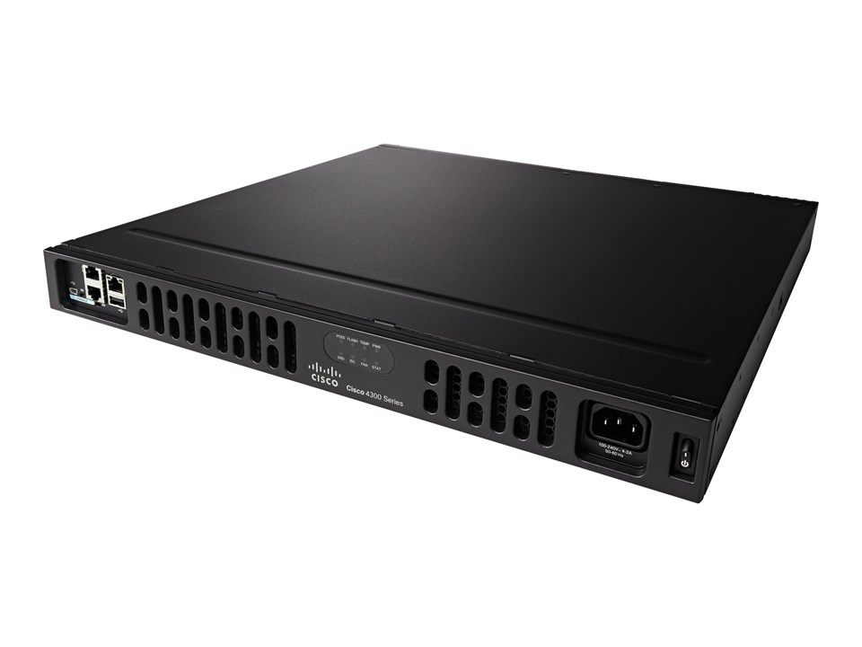
Router
Cisco ISR 4331

Slide 9
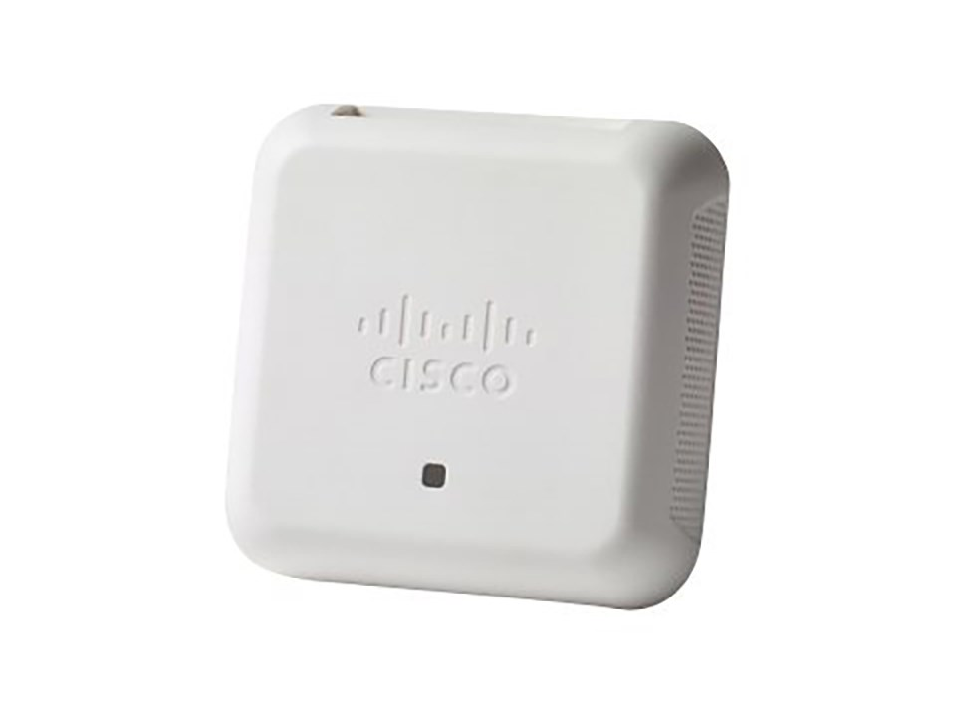
Accesspunkt
Cisco WAP150

Slide 10
Switch
Cisco Small Business SG350X-48MP

Slide 11
Totalsumma 604 314 kronor

